Slide 1
Artificial Intelligence Non-Monotonic Reasoning
unknown
RL
known
deterministic
stochastic
atomic
SEARCH
MDPs
factored
LOGIC
Bayes nets
structured
First-order logic

Slide 2
Non-Monotonic Reasoning Automated reasoning in the absence of complete knowledge about the world
ARTIFICIAL INTELLIGENCE

Slide 3
Reasoning in Artificial Intelligence
Reasoning:
Process to infer facts from existing data
Infer facts: deriving logical conclusion and making predictions
Existing data: available knowledge, facts, and beliefs.
Example:
Robins are birds.
All birds have wings.
Then if we ask: Do robins have wings?

Slide 4
Types of Reasoning
Deductive reasoning
Inductive reasoning
Abductive reasoning
Common Sense Reasoning
Monotonic Reasoning
Non-monotonic Reasoning

Slide 5
Deductive Reasoning
Deducing new information from logically related known information
Requires various rules and facts
Top-down approach
The truth of the premises guarantees the truth of the conclusion.
Starts from the general premises to the specific conclusion
Example:
Premise-1: All the human eats veggies
Premise-2: Suresh is human
Conclusion: Suresh eats veggies

Slide 6
Inductive Reasoning
Arrive at a conclusion using limited sets of facts by the process of generalization.
Also known as cause-effect reasoning
Bottom-up Approach
Use historical data or various premises to generate a generic rule, for which premises support the conclusion.
Example:
Premise: All of the pigeons we have seen in the zoo are white.
Conclusion: Therefore, we can expect all the pigeons to be white.

Slide 7
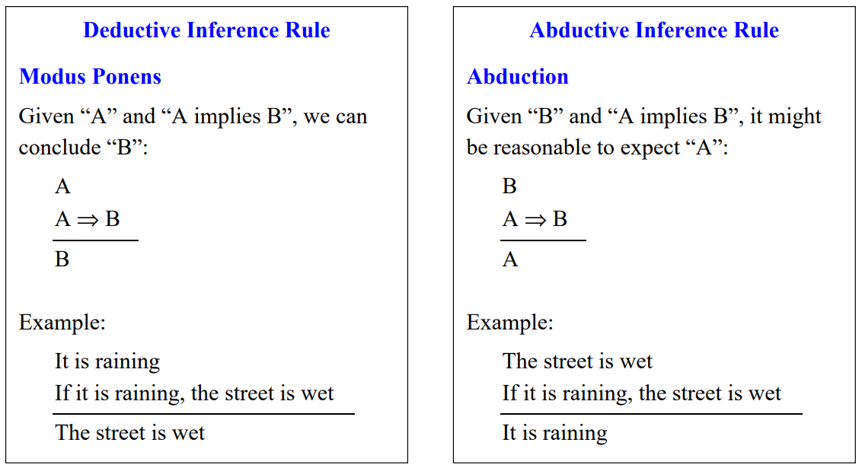
Abductive Reasoning
Starts with single or multiple observations then seeks to find the most likely explanation or conclusion for the observation.
Extension of deductive reasoning.

Slide 8
Common Sense Reasoning
Informal form of reasoning, which can be gained through experiences.
Relies on good judgment rather than exact logic.
Operates on heuristic knowledge and heuristic rules.
Example:
One person can be at one place at a time.
If I put my hand in a fire, then it will burn.
Example:
Facts: you are outside, Raining, Has_Umbrella
Rule: Raining ∧ Outside ∧ Has_Umbrella ⇒ Dry

Slide 9
World Assumption
The Closed World Assumption:
If something is not explicitly known or provable, then it is false.
The Open World Assumption:
If something is not explicitly known or provable, then it is unknown.
This assumption in reasoning can easily lead to faulty reasoning because its impossible to know everything.
These are forms of assumption-based reasoning.

Slide 10
Monotonic Logic
Derive the valid conclusion (fact) from the available facts (KB)
Available facts will not be affected by derived new facts.
Logic-based system is monotonic.
If KB ╞ α₁ , then (KB ∪ α₁)╞ α₂, never contradicts α₁ ∴ α₁ and α₂ are consistent.
The logic that we have explored so far (first order predicate calculus with chaining or resolution) is monotonic.
Example:
Facts: You are outside, Raining, Has_Umbrella
Rule: Raining ∧ Outside ∧ Has_Umbrella ⇒ Dry
Facts: You are outside, Raining, Has_Umbrella, Dry

Slide 11
Non-monotonic Logic (NML)
Unfortunately, the world is an uncertain place.
If KB ╞ α₁ , then (KB ∪ α₁)╞ α₂, contradicts α₁
∴ α₁ and α₂ are inconsistent.
The real world, however, is too complex and there exist situations, where α₂ contradicts α₁.
Example:
Facts: You are dry, you are outside, Raining, ¬Has_Umbrella
Rule: Raining ∧ Outside ∧ ¬Has_Umbrella ⇒ Wet
∴ Dry contradicts Wet
Update Facts: You are Wet, you are outside, Raining, ¬Has_Umbrella

Slide 12
Uncertain Reasoning
System must be able to deal with:
Incompleteness: compensate for lack of knowledge.
Inconsistencies: resolve ambiguities and contradictions.
Change: it must be able to update its world knowledge base over time.
Methods to deal with uncertainty:
Symbolic
Statistical
Fuzzy logic

Slide 13
Non-Monotonic Reasoning
Extension of first-order predicate logic to include a modal operator, M
Placed before the predicate is read as is consistent with
∀x good_student(x) ∧ M study-hard(x) ⇒ graduates(x)
This clause can be read: For all x where x is a good student, and if the fact that x studies hard is consistent with everything else we know, then x will graduate.
difficult part here is defining precisely what is consistent with everything else we know.
is consistent with everything else we know may not be decidable.

Slide 14
Non-Monotonic Reasoning
Extension of first-order predicate logic to include a modal operator, M
Placed before the predicate is read as is consistent with
Suppose a person, Peter, is a good student but also seriously enjoys parties.
∀x good_student(x) ∧ M study-hard(x) ⇒ graduates(x)
∀y party-person(y) ∧ M ¬study-hard(y) ⇒ ¬graduates(y)
good_student(peter)
party-person(peter)
Infer both that Peter will and will not graduate!

Slide 15
Non-Monotonic Reasoning
There are two ways to address undecidability.
Use a negation as failure proof to demonstrate is consistent with
Attempt the proof of ¬(stuoyhard(x))
if we couldn't prove that x doesn't study, then we assume that x does study.
Make a heuristic-based and limited (time or memory limited) search for the truth of the predicate
study-hard(x), and then, if there is no contrary evidence, assume it to be true

Slide 16
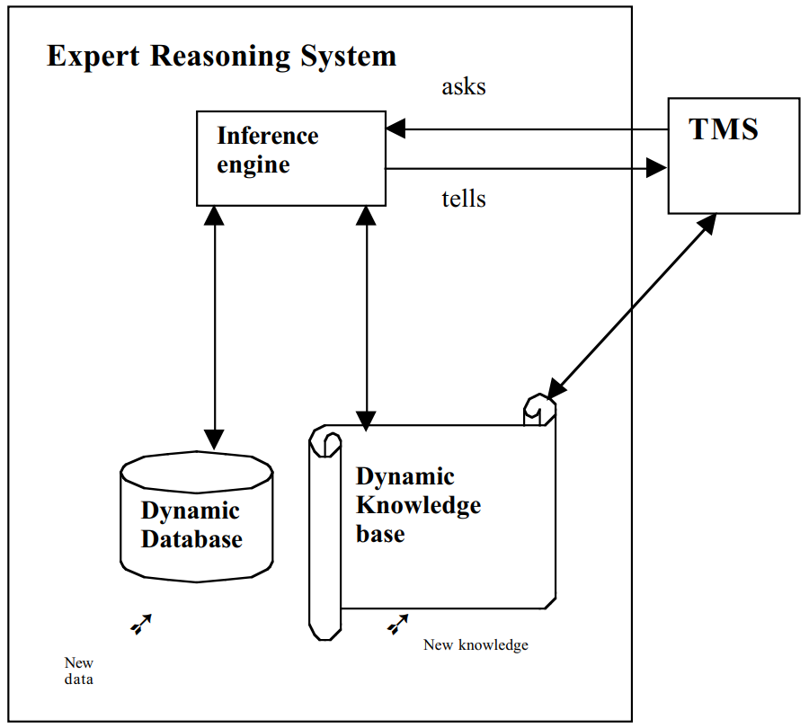
Truth Maintenance System
Most practical systems for non-monotonic reasoning
Helps the reasoning system to maintain the consistency among the inferences
Works with an expert system or decision support system
TMS ask about current inferences to IE
TMC attempts to resolve the inconsistency between the old and current inferences
The TMS then groups the set of consistent information and tells the same to the IE

Slide 17
Truth Maintenance System
Inferences are supported by evidence
Graph-based representation
support dependency-directed backtracking
Ability to backtrack directly to the point in the space where the problem occurs, and to make adjustments to the solution at that state.
Avoid re-searching the entire search space.
Simplifies how to make changes when new evidence is introduced or when an assumption is shown to be false
Types:
Justification TMS (JTMS)
Assumption-based TMS (ATMS)
Logic-based TMS (LTMS),
Multiple belief reasoners (MBR)

Slide 18
Justification TMS
The current status of all inferences/information is labeled by:
IN node: “believed” (IN does not mean TRUE)
Inference is supported by items that must be true
OUT node: “not believed”
inference is supported by items that must be false
 | P IN | P OUT
(not P) IN | Contradiction | not P true
(not P) OUT | P true | Don’t know

Slide 19
JTMS Justification
N1
J1
N3
N2
Here N1 and N2 are the antecedents of justification, J1, and N3 is the consequent.
A justification is valid if its antecedents are: IN.
There are two types of justification
Support list (SL): (SL <in-node> <out-node>)
Conditional proofs (CP): (CP <consequent> <in-hypothesis> <out-hypothesis>)

Slide 20
Justification TMS
The current status of all inferences/information is labeled by:
IN node:
Nodes (information) are active
Inference is supported by items that must be true
OUT node:
nodes have to be retracted from the current reasoning space
inference is supported by items that must be false
There are two types of justification
Support list (SL): (SL <in-node> <out-node>)
Conditional proofs (CP): (CP <consequent> <in-hypothesis> <out-hypothesis>)

Slide 22
Example
Mita likes to accompany her husband when buying some household items in the market place, located at Gariahat in Calcutta. Further, she prefers to visit the market next Monday evening, since the crowd is normally less on Monday evenings. However, on Saturday it was learnt that the market offers a special rebate on a few items, starting next Monday. So, Mita revised her decision not to go to the market this Monday and selects the next Monday for her visit. Later it was found that her husband had an official emergency meeting on the next Monday evening and accordingly Mita had to postpone her visit on that evening. Later, the time of the emergency meeting was shifted to an early date and Mita happily agreed to visit the market with her husband the next Monday evening.

Slide 23
Given
Knowledge Base:
PR1: Crowd-is (large, at-market, at-time-T) ⇒ ¬Visits ( Wife, market, at-time-T)
PR2: Visits (Wife, market-at-time-T) ⇒ Accompanies (Husband, Wife, at-time-T)
PR3: Offers (market, rebate, at-time -T) ⇒ Crowd-is (large, at-market, at-time-T)
PR4: Has-Official-meeting (Husband, at-time-T) ⇒ ¬ Accompany (Husband, Wife, at-time-T)
PR5: ¬Visits (Wife, market, Monday-evening) ⇒ Visits (Wife, market, next-Monday-evening).
Database:
Offers (market, rebate, Monday-evening)
Has-Official-meeting (Husband, next-Monday-evening)
Meeting-shifted (from, next-Monday-evening)

Slide 24
JTMS Trace
Node Status Meaning SL / CP
n1 IN Offers (mar, reb, mon-eve) (SL ( ) ( ))
n2 IN Crowd-is (lar, at-mar, mon-eve) (SL(n1) ( ))
n3 IN ¬Visits (mita, mar, mon-eve) (SL (n2) ( ))
n4 IN Visits (mita, mar, next-mon-eve) (SL (n3) ( ))
n5 IN Has-meeting (ram, next-mon-eve) (SL ( ) ( ))
n6 IN ¬Accompanies (ram, mita, next-mon-eve) (SL (n5) ( ))
n7 IN Accompanies (ram, mita, next-mon-eve) (SL (n4) (n6))
n8 IN contradiction (SL (n6, n7) ( ))
n9 IN no-good n7 (CP n8 (n6, n7) ( ))
Now with a new data item 3
n10 IN Meeting-shifted (from, next-mon-eve) (SL ( ) (n5))
n11 IN contradiction (SL (n5, n10) ( ))
n12 IN no-good n5 (CP n11 (n5, n10) ( ))
n5 OUT (SL (n12) ( ))

Slide 25
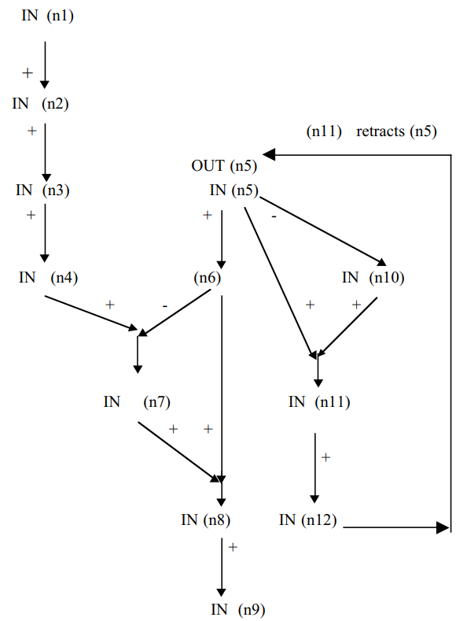
JTMS Graph

